Slide 1
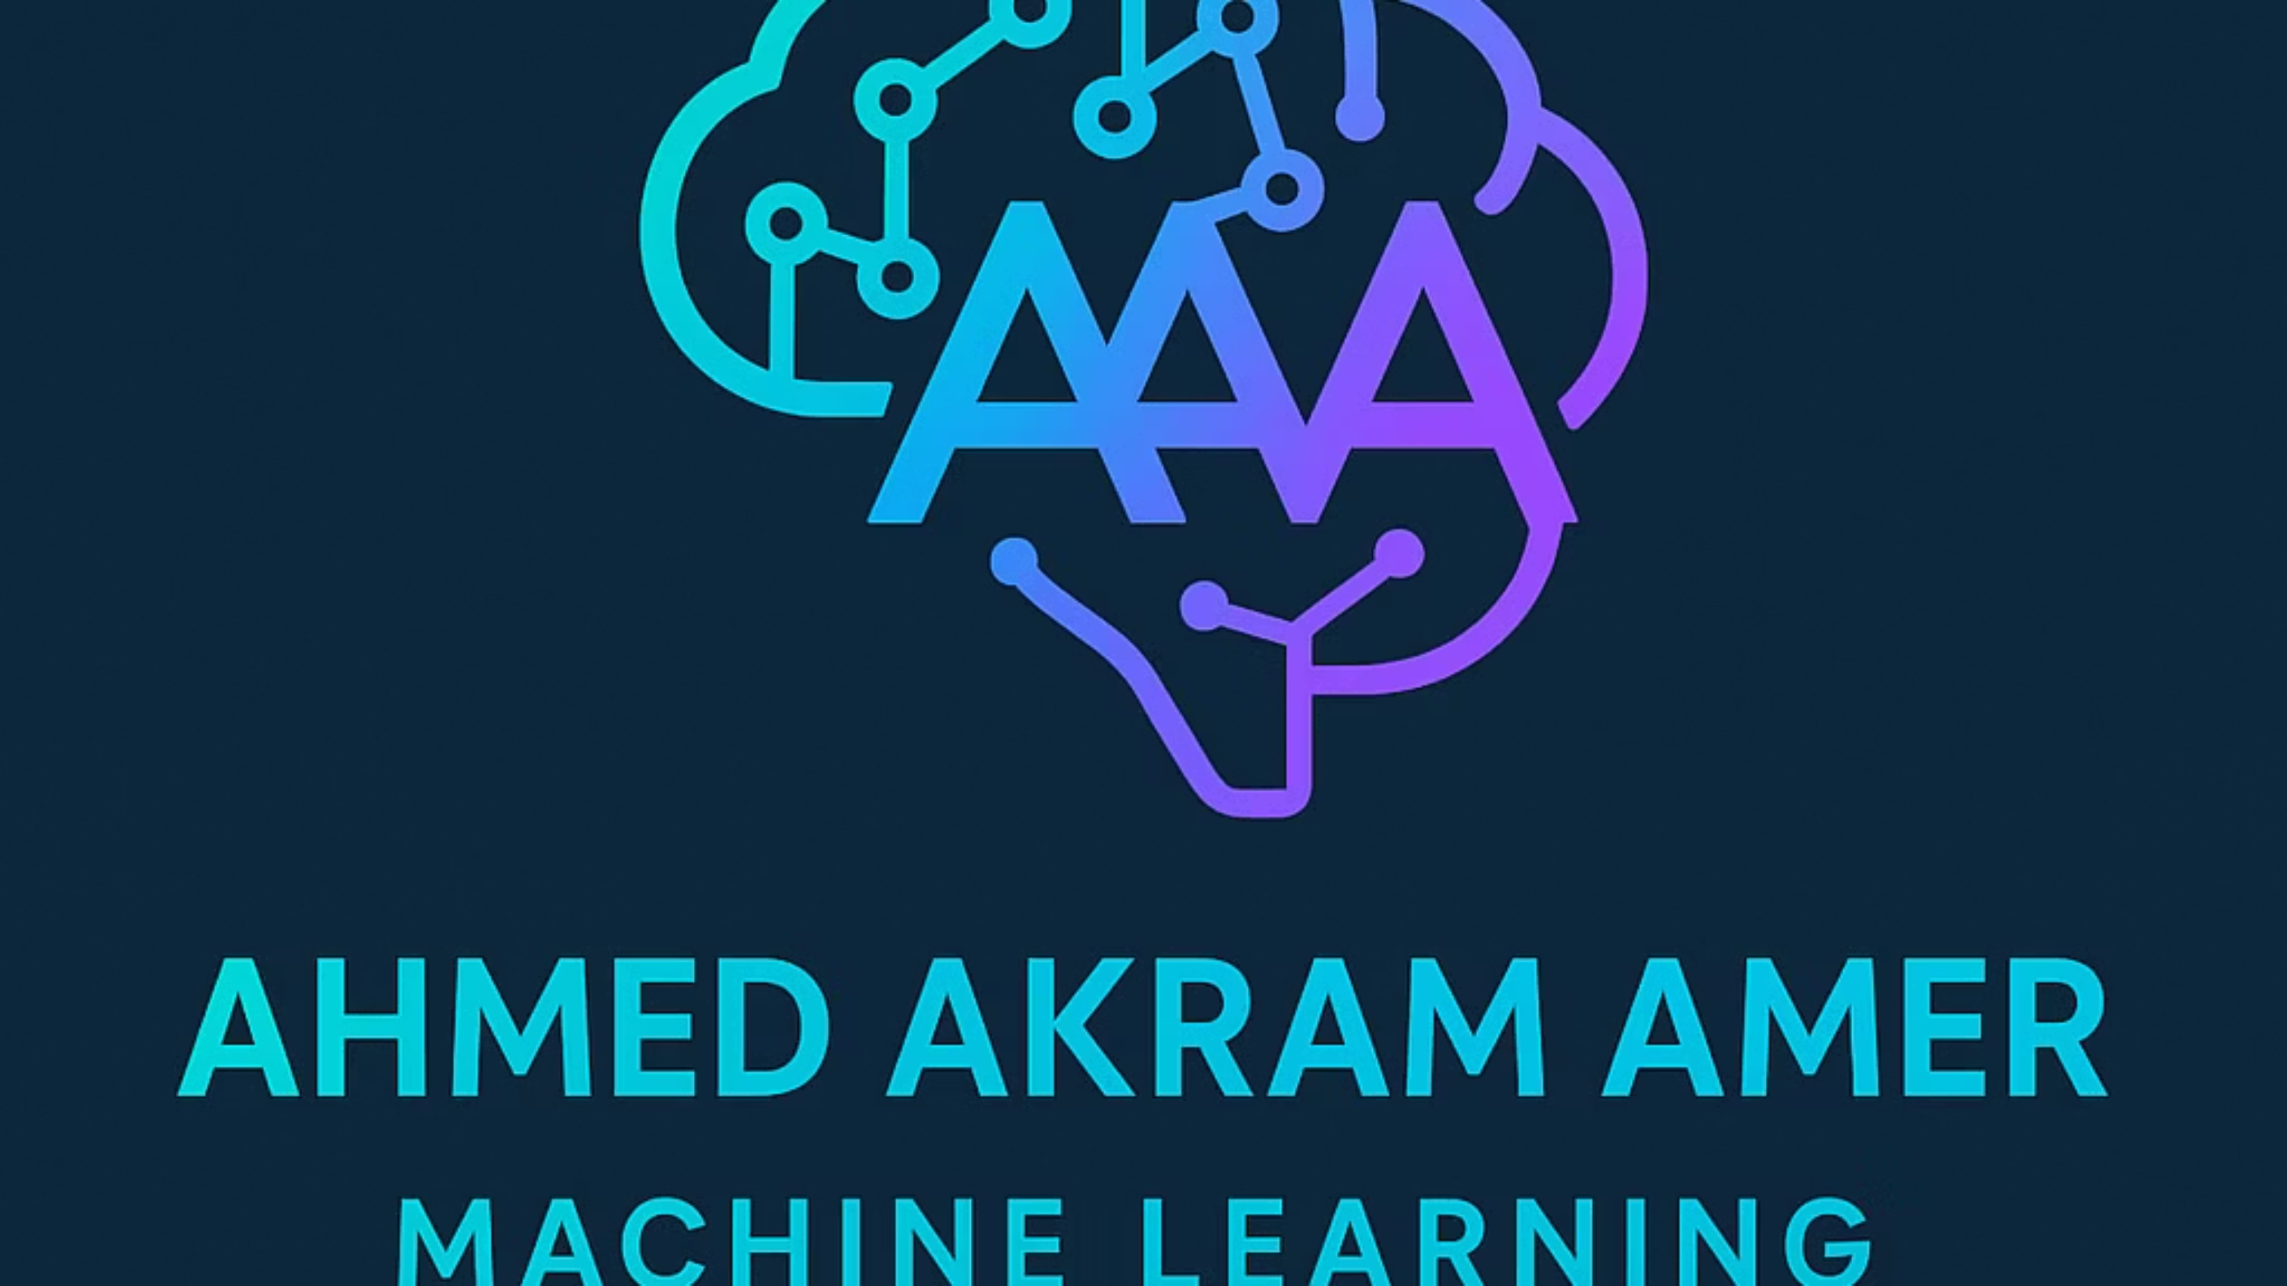
Supervised Machine Learning: Unlocking Predictive Power from Data
Welcome to an exploration of Supervised Machine Learning, a pivotal field in artificial intelligence that empowers systems to learn from experience and make accurate predictions. This presentation will guide you through its foundational concepts, practical applications, and future potential.

Slide 2


What is Supervised Machine Learning?
Learning from Labeled Data
Guided Learning Process
Predictive Power
Once trained, the model can predict outcomes for new, unseen data. This predictive capability is at the heart of many modern AI applications.
Supervised Machine Learning is a fundamental approach where algorithms learn from data that has been "labeled," meaning each input example is paired with its correct output.
Think of it as a student learning under a teacher's guidance. The model is fed numerous examples of input-output pairs, allowing it to discern patterns and relationships independently.
From identifying spam emails to recognizing objects in images and assisting in medical diagnoses, supervised learning forms the backbone of intelligent systems that learn and adapt. It's about empowering machines to make informed decisions based on historical patterns.

Slide 3
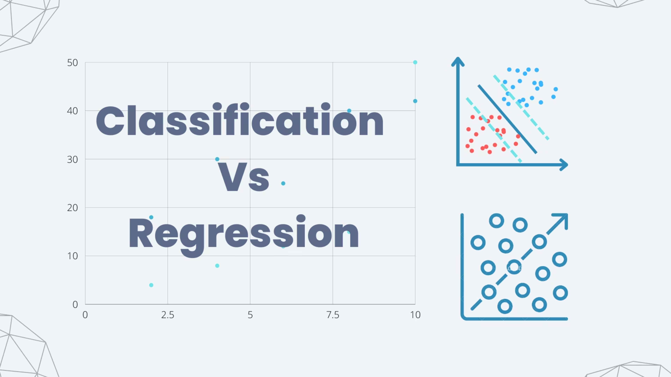
Types of Supervised Learning
Supervised learning broadly categorizes into two main types, each addressing different prediction goals. Understanding these distinctions is key to selecting the right approach for a given problem.
1
2
Classification
Regression
Predicts discrete, categorical outcomes. Examples include determining if an email is spam (yes/no), identifying a digit from an image (0-9), or classifying a tumor as benign or malignant.
Predicts continuous numerical values. This could involve forecasting house prices based on features like size and location, predicting tomorrow's temperature, or estimating a person's age from their facial features.
Common algorithms include Logistic Regression for classification tasks and Linear Regression for predicting continuous values, though many other sophisticated algorithms exist within both categories.

Slide 4
Key Terminology & Concepts
Navigating supervised machine learning requires familiarity with its core vocabulary. These terms define the components and processes essential to building and evaluating predictive models.
Training Data & Features
Model & Overfitting
Cross-validation
The dataset used to teach the model, consisting of input features (independent variables) and their corresponding labels (correct output values).
The model is the learned function. Overfitting occurs when a model learns the training data too well, capturing noise instead of general patterns, leading to poor performance on new data.
A robust technique for evaluating how a model will generalize to an independent dataset, helping to detect and mitigate overfitting.
Understanding these terms is crucial for anyone working with or discussing supervised machine learning, enabling clearer communication and more effective problem-solving.

Slide 5
Main Challenges in Supervised Learning
While powerful, supervised learning comes with its own set of significant challenges that can impact model performance and reliability. Addressing these requires careful consideration and strategic solutions.
Data Quality & Bias
Overfitting vs. Underfitting
High Dimensionality & Imbalanced Classes
Poor quality, incomplete, or biased labeled data can lead to skewed models that perpetuate existing societal biases or perform inaccurately on real-world data.
The delicate balance between a model that is too complex (overfitting) and one that is too simple (underfitting) is a constant challenge, requiring careful tuning.
Handling datasets with a vast number of features (high dimensionality) can overwhelm models, while rare categories (imbalanced classes) can be ignored, leading to poor predictions for critical cases.
(Garbage In → Garbage Out)
Effectively mitigating these issues is paramount to building robust and dependable supervised machine learning systems.

Slide 6
How to Overcome These Challenges
Successfully deploying supervised learning models requires proactive strategies to tackle common challenges. Here are key approaches to enhance data quality and model robustness.
Improving Data Quality
Managing High Dimensionality
Employ data cleaning techniques to handle missing values, correct errors, and reduce noise. Data augmentation can artificially expand datasets by creating new, plausible examples from existing ones.
Apply feature selection to identify and retain only the most relevant features. Dimensionality reduction techniques like Principal Component Analysis (PCA) transform high-dimensional data into a lower-dimensional representation while preserving critical information.
Addressing Overfitting
Utilize regularization methods that penalize overly complex models, or pruning in tree-based models to remove branches that do not contribute significantly to generalization.
Balancing Imbalanced Classes
Use resampling techniques such as SMOTE (Synthetic Minority Over-sampling Technique) to oversample minority classes or undersample majority classes, ensuring the model pays adequate attention to all categories.

Slide 7
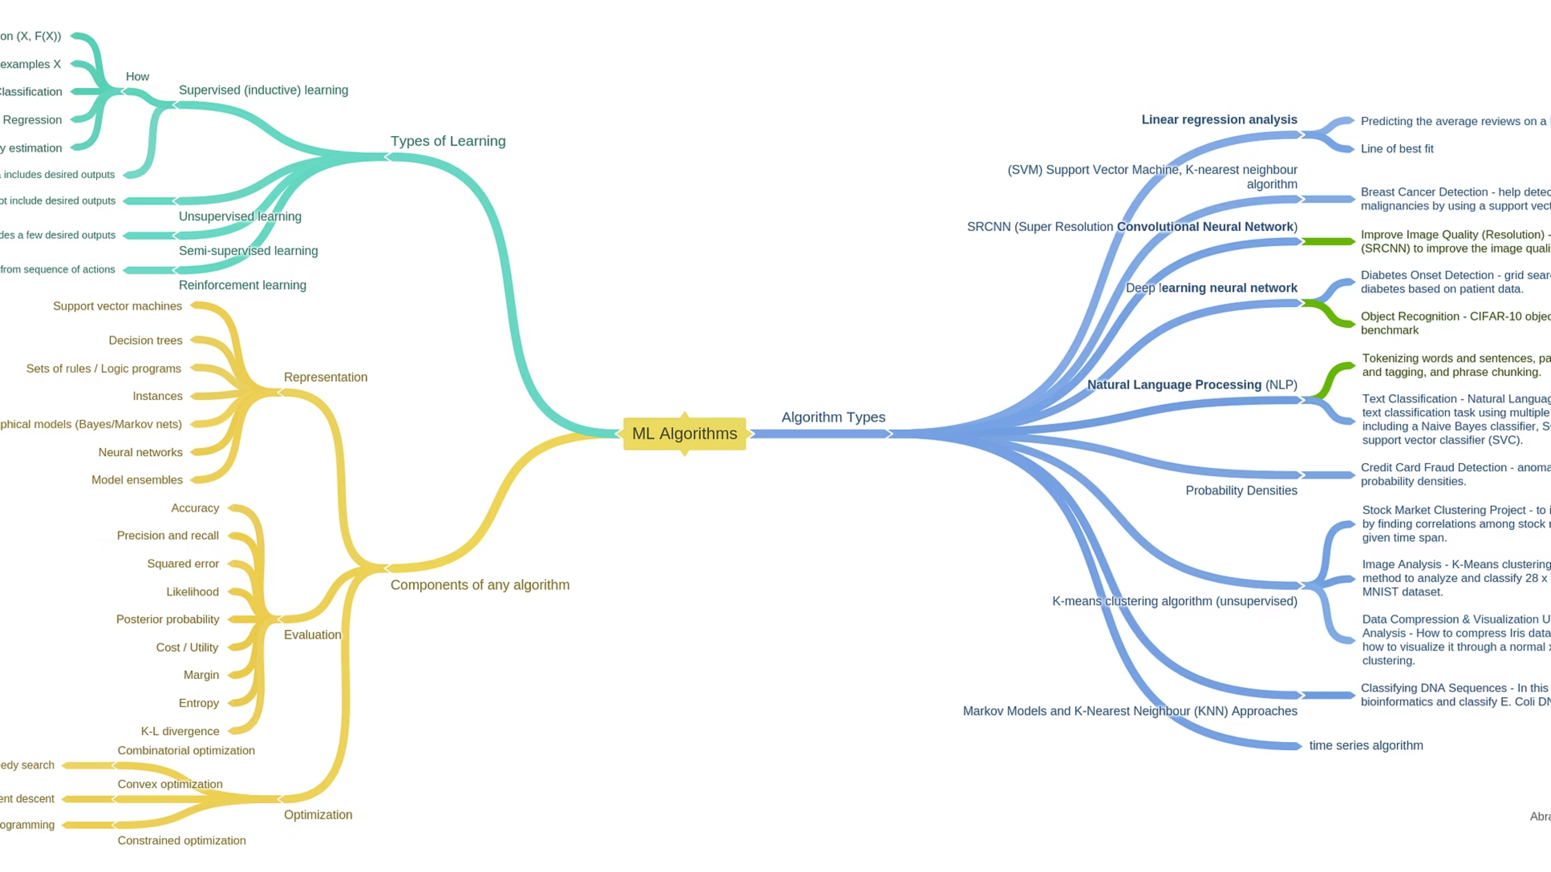
Popular Supervised Learning Algorithms
The supervised learning landscape is rich with diverse algorithms, each suited for different data types and problem complexities. Here are some of the most widely used and impactful ones.
Decision Trees & Random Forests
1
Intuitive, interpretable models that mimic human decision-making. Random Forests combine multiple decision trees for improved accuracy and robustness.
Support Vector Machines (SVM)
2
Powerful for classification tasks, especially in high-dimensional spaces, by finding the optimal hyperplane that separates data points.
Neural Networks
3
Inspired by the human brain, these are highly effective for complex pattern recognition, forming the foundation of deep learning for tasks like image and speech processing.
Gradient Boosting Machines
4
Algorithms like XGBoost and LightGBM are state-of-the-art for tabular data, sequentially building an ensemble of weak prediction models.

Slide 8



Tools & Frameworks for Practical Applications
Implementing supervised machine learning in practice relies on a robust ecosystem of software tools and frameworks that simplify development, training, and deployment.
Python Libraries
AutoML Platforms
Data Labeling Tools
Essential tools like scikit-learn for traditional ML algorithms, and TensorFlow and PyTorch for deep learning provide rich functionalities.
Platforms such as Google AutoML, H2O.ai, and Microsoft Azure ML automate parts of the ML workflow, accelerating model development.
Specialized tools like SuperAnnotate and Labelbox are critical for creating and managing high-quality labeled datasets, which are the bedrock of supervised learning.
These tools, combined with the scalability of cloud services, empower developers and data scientists to build, train, and deploy sophisticated ML solutions efficiently.

Slide 9




Real-World Impact & Use Cases
Supervised machine learning has revolutionized countless industries, driving innovation and efficiency across diverse applications. Its ability to derive insights from data translates into tangible benefits.
Healthcare
Finance
Predicting disease progression, aiding in early diagnosis from medical images, and personalizing treatment plans for patients.
Detecting fraudulent transactions in real-time, assessing credit risk for loan applications, and optimizing investment strategies.
Retail
Autonomous Vehicles
Forecasting customer churn, personalizing product recommendations, and optimizing inventory management.
Enabling object detection, pedestrian recognition, and critical decision-making for safe navigation.
These examples underscore the pervasive influence of supervised learning in solving complex, real-world problems and creating intelligent systems.

Slide 10



The Future of Supervised Learning
Towards Less Labeled Data
Future advancements will increasingly focus on reducing the reliance on expensive labeled data through self-supervised and semi-supervised learning techniques.
Explainable AI (XAI)
Building trust in AI decisions through enhanced explainability, making models more transparent and understandable, especially in critical applications.
Real-time & Edge Computing
Growing integration with big data and edge computing will enable supervised models to deliver real-time predictions directly at the source of data generation.
Supervised learning remains a cornerstone of AI, continuously evolving to empower smarter, more informed, and data-driven decisions across the globe.

